Slide 1

World Cup 2023 Analysis
Project # 02
Mentorness Internship Program

Slide 2
Unveiling the Untold Stories of Cricket's Greatest Spectacle

Slide 3
Introduction to World Cup Analysis
Importance of the World Cup:
Celebrated as the pinnacle of cricketing excellence.
Revered for its rich history, iconic moments, and global impact.
Offers a unique opportunity to analyze and understand the dynamics of cricket.
Purpose of Analysis:
To uncover hidden trends, patterns, and insights.
To identify key factors influencing team performance.
To provide a deeper understanding of the game and its evolution over time.

Slide 4
Introduction to World Cup Analysis
Scope of Analysis:
Examining team and player performances.
Analyzing match outcomes and strategies.
Exploring the impact of external factors such as venue and conditions.
Conclusion:
Join us as we delve into the world of cricket's most prestigious event, unraveling its mysteries and celebrating its greatness.

Slide 5
Approach
Data Acquisition and transformation.
Team Performance Analysis.
Player Performance Analysis.
Opposition and Ground Analysis.
Temporal Analysis.
Prediction Model.

Slide 6

Data Acquisition and Transformation

Slide 7
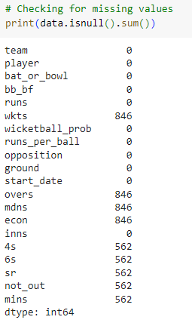
Data Acquisition and Transformation
Import the important libraries
Loading the data into a data frame
Checking if any columns have null values.

Slide 8
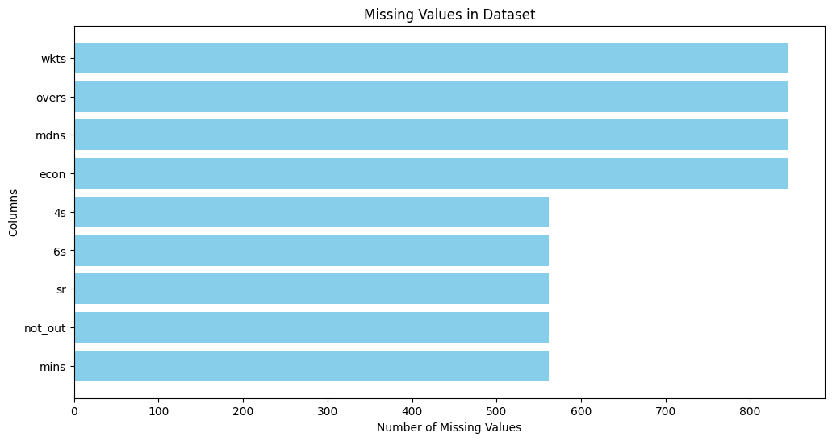
Data Acquisition and Transformation
9 columns in the data set have missing values.
9 columns in the data set have missing values.
9 columns in the data set have missing values.
9 columns in the data set have missing values.
9 columns in the data set have missing values.
9 columns in the data set have missing values.
Impute the missing values, numerical values by their mean and the categorical values by their mode.
Recheck if there are any missing values.

Slide 9
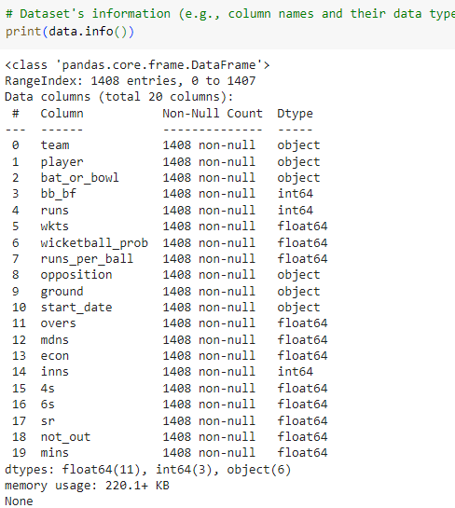
Data Acquisition and Transformation
We check dataset’s information.
This helps us identify the data types we are dealing with for each attribute

Slide 10
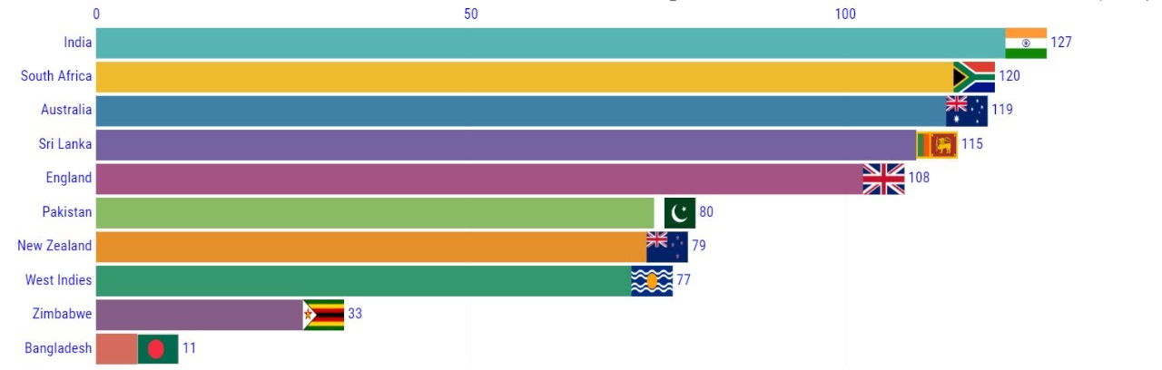
Team Performance Analysis

Slide 11
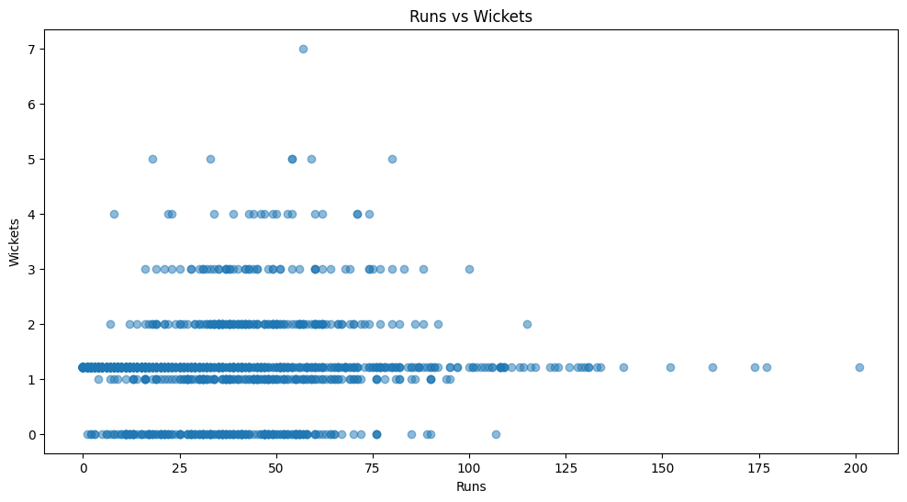
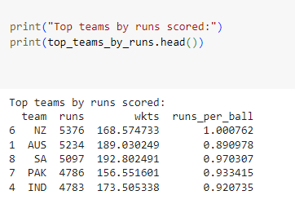
Team Performance Analysis
Checked team performance based on runs and wickets.
Sorted teams based on total runs scored

Slide 12
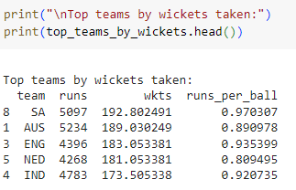
Team Performance Analysis
Sorted teams based on total wickets taken.
Analyzed the distribution of 'bat_or_bowl' values for top-performing teams.
Analyzing the individual player performance within each top-performing team.

Slide 13
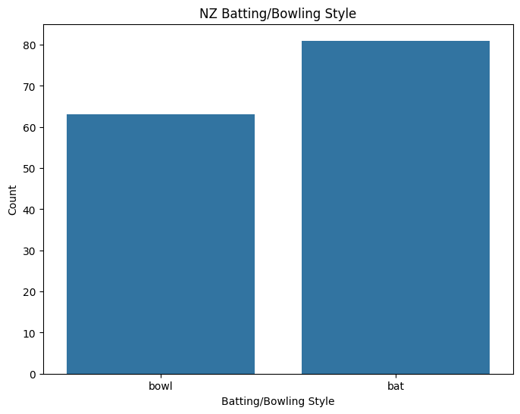
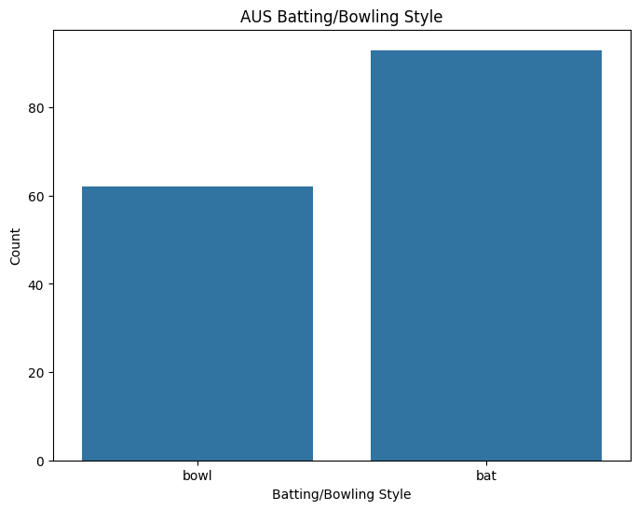
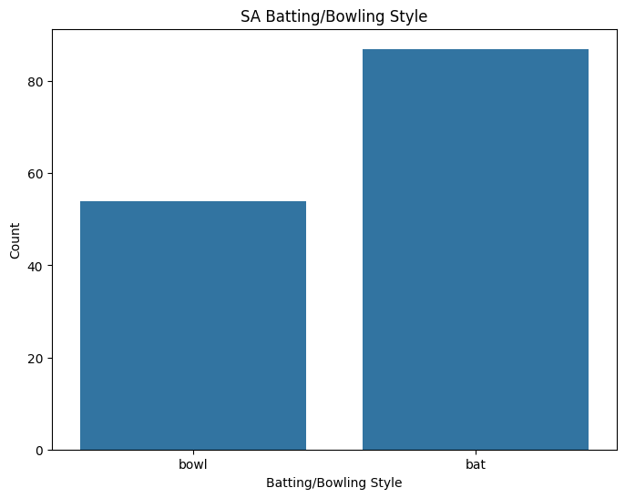
Distribution of 'bat_or_bowl' values for top-performing teams.

Slide 14
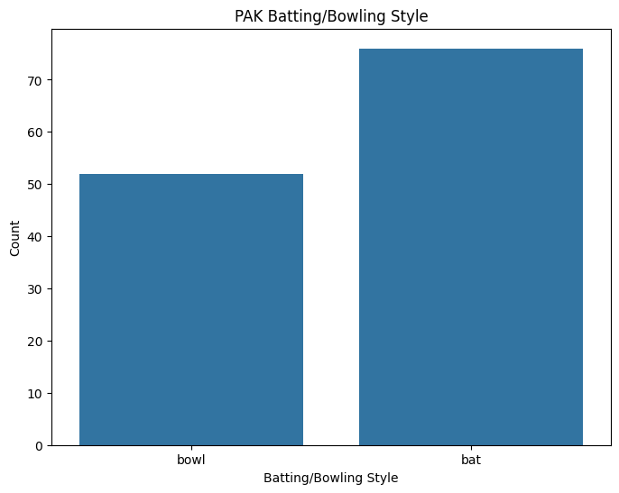
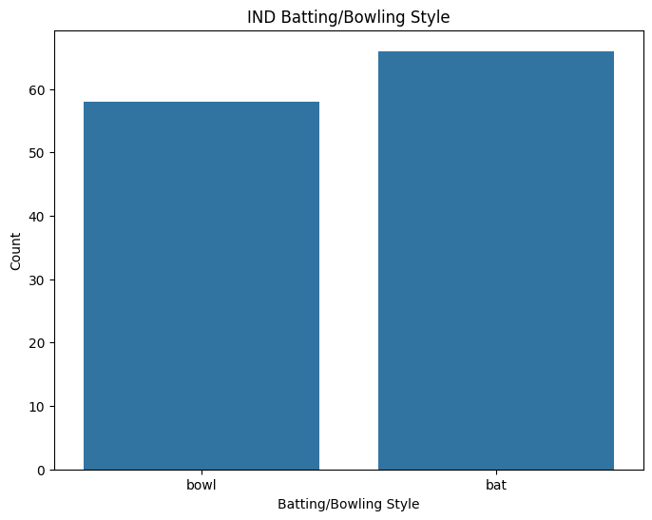
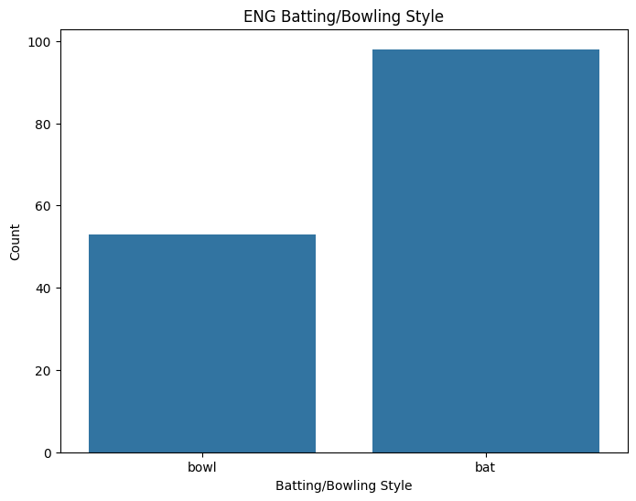
Distribution of 'bat_or_bowl' values for top-performing teams.

Slide 15
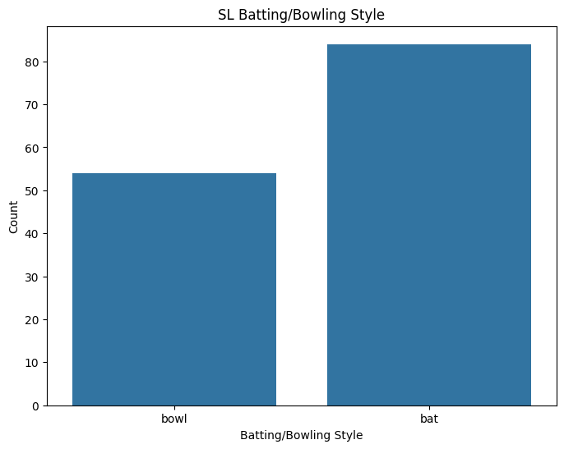
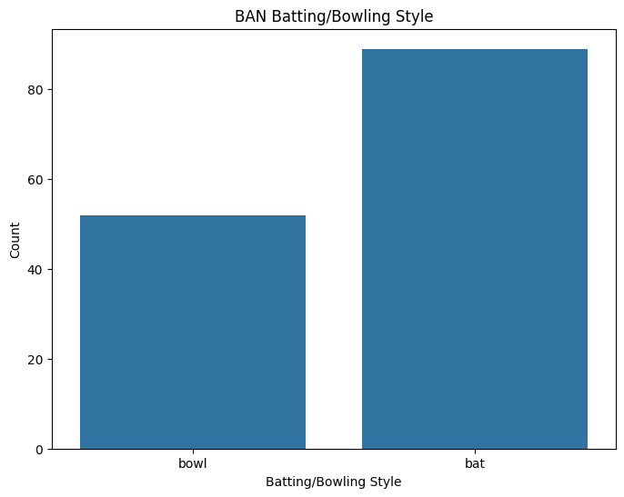
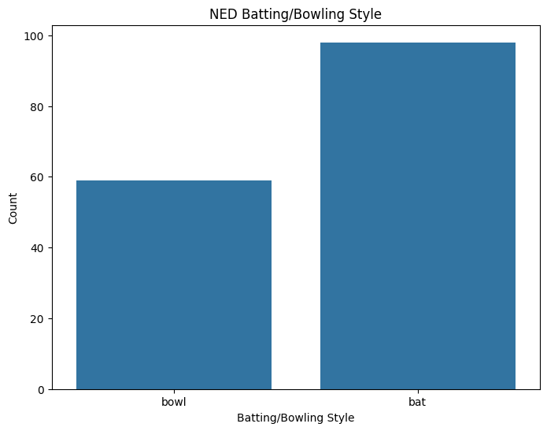
Distribution of 'bat_or_bowl' values for top-performing teams.

Slide 16
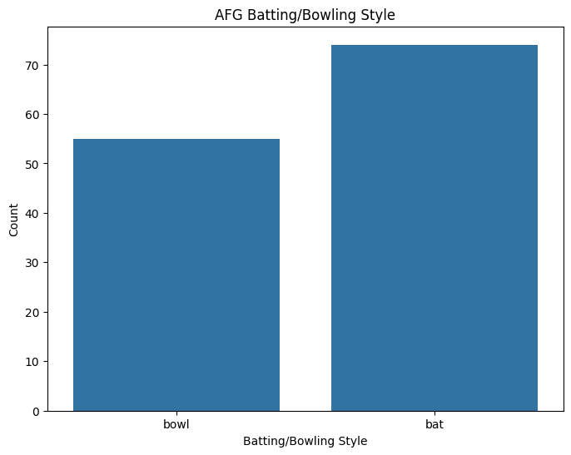
Distribution of 'bat_or_bowl' values for top-performing teams.
Batting Style Comparison:
England (ENG) has the highest average batting style score of 98, followed by Australia (AUS) and Netherlands (NED) with 93 and 98 respectively.
India (IND) and New Zealand (NZ) have relatively lower batting style scores of 66 and 81 respectively.
Bowling Style Comparison:
England (ENG) has the highest average bowling style score of 53, followed by South Africa (SA) with 54.
Pakistan (PAK) and Bangladesh (BAN) have the lowest bowling style scores of 52.
Overall Comparison:
England (ENG) emerges as the top-performing team in terms of both batting and bowling style, indicating a well-balanced performance.
India (IND) and New Zealand (NZ) have strong batting but relatively weaker bowling performances.
Pakistan (PAK), Bangladesh (BAN), and Afghanistan (AFG) show consistent but moderate performances in both batting and bowling styles.

Slide 17
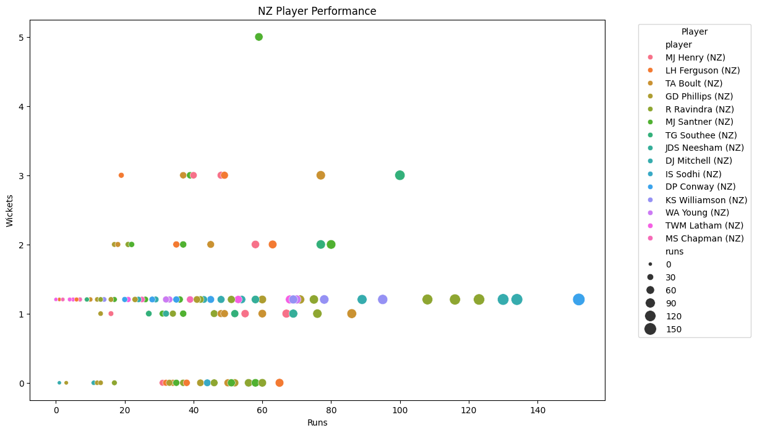
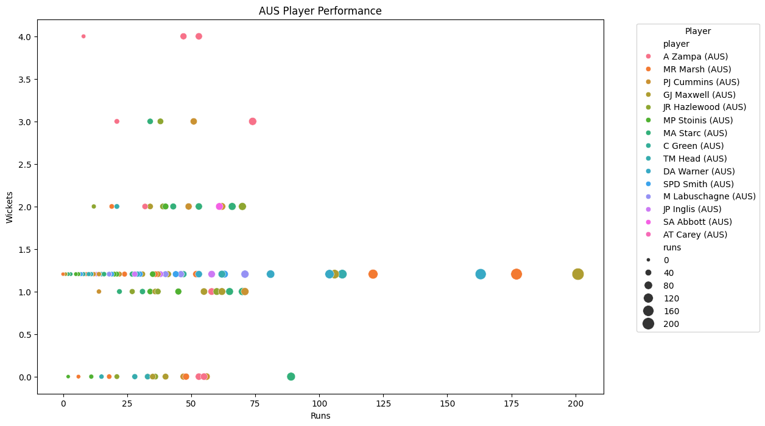
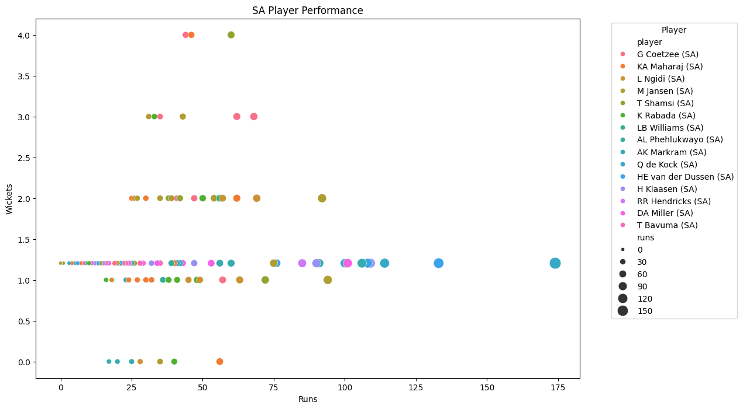
Individual player performance within each top-performing team

Slide 18
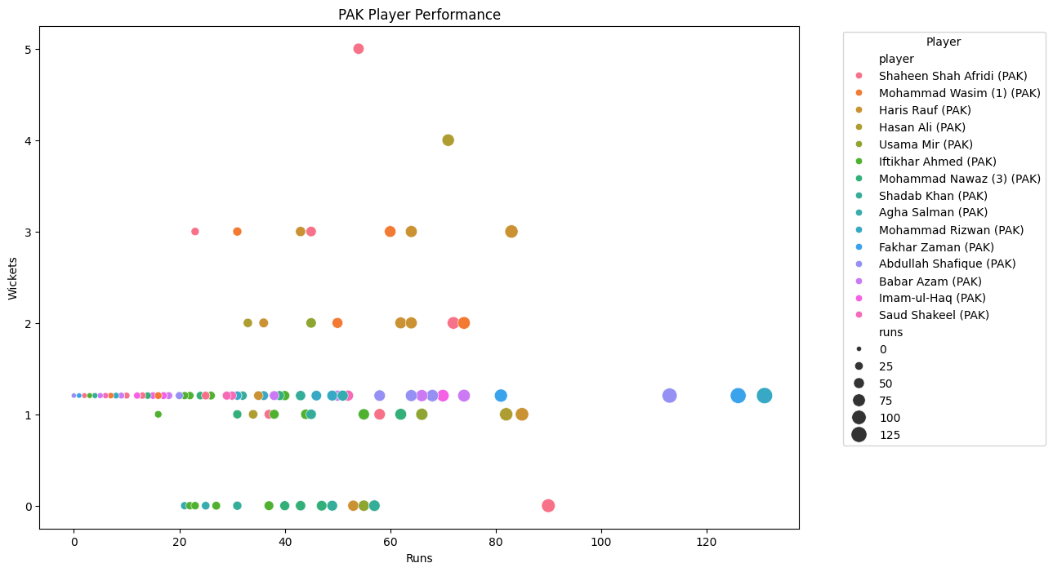
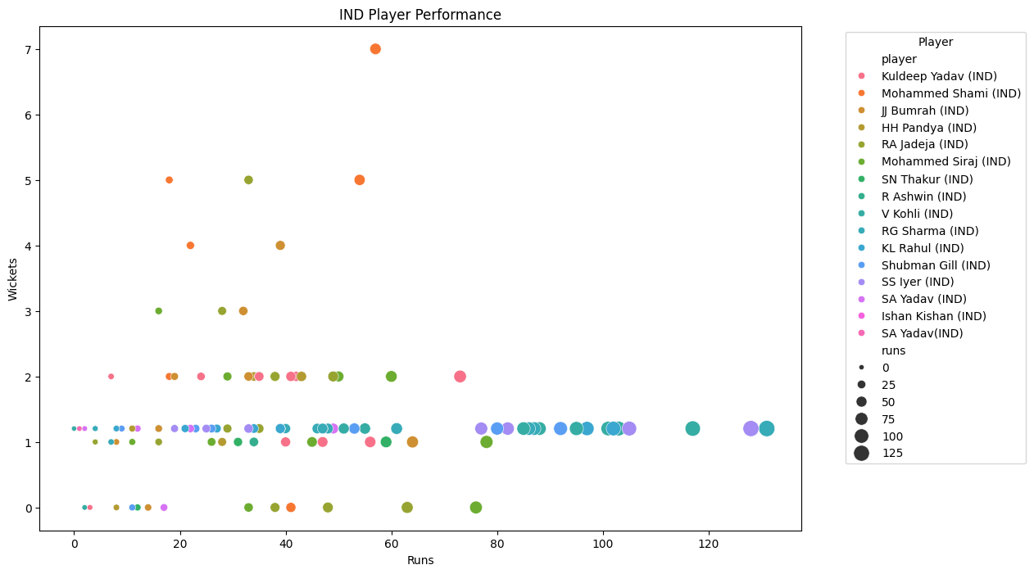
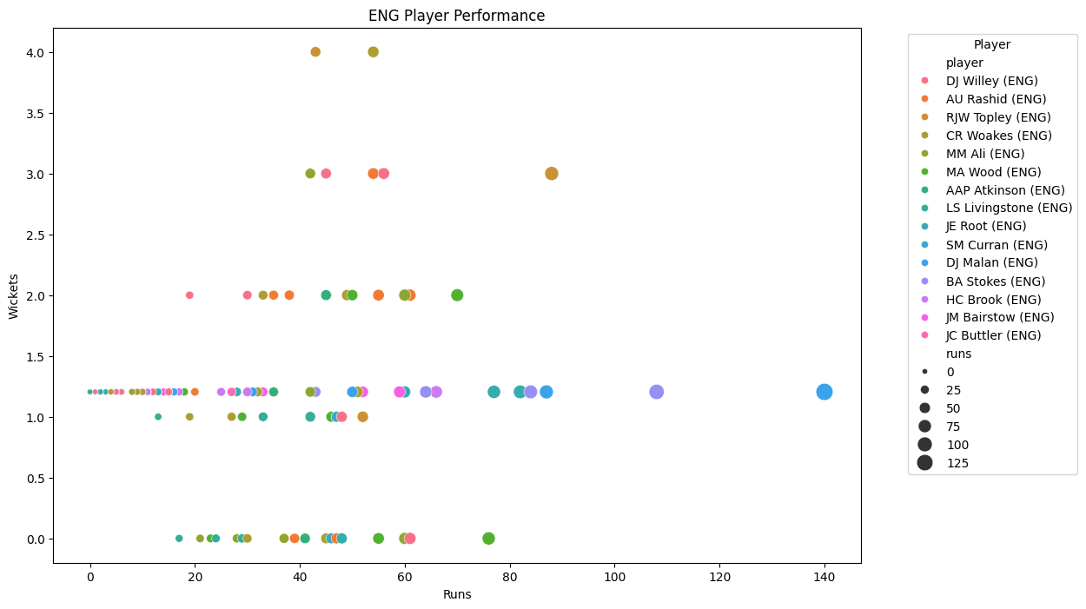
Individual player performance within each top-performing team

Slide 19
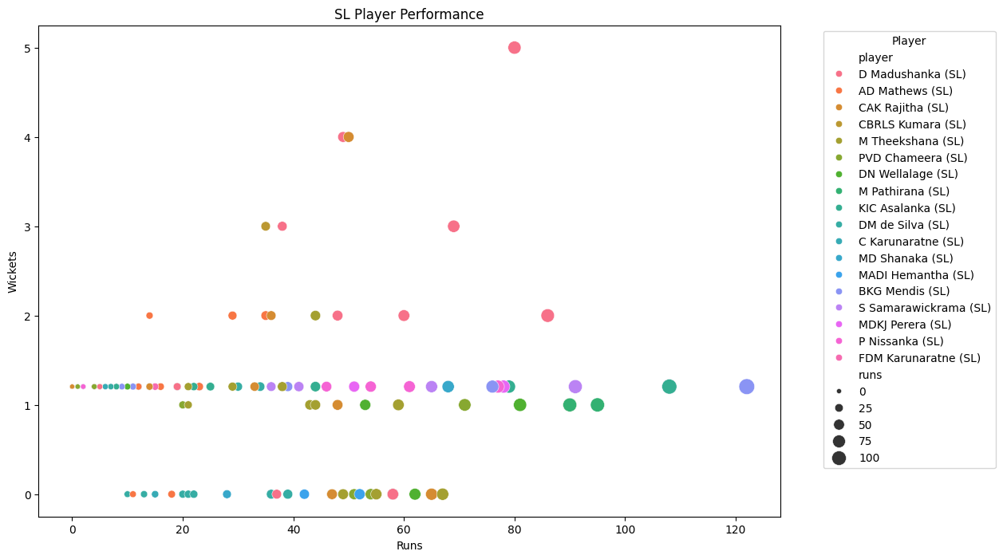
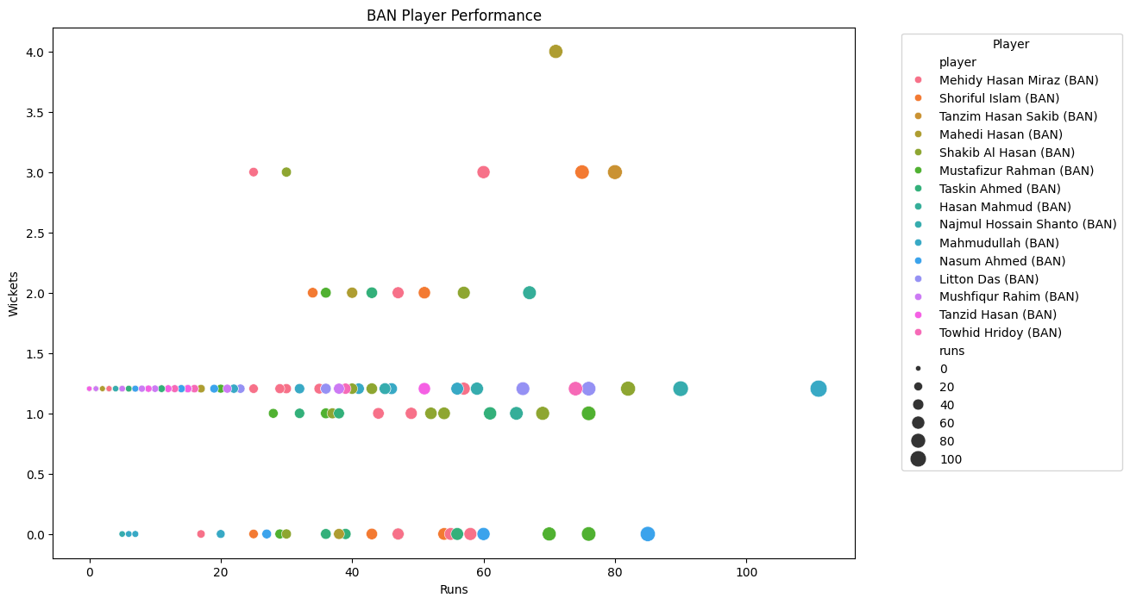
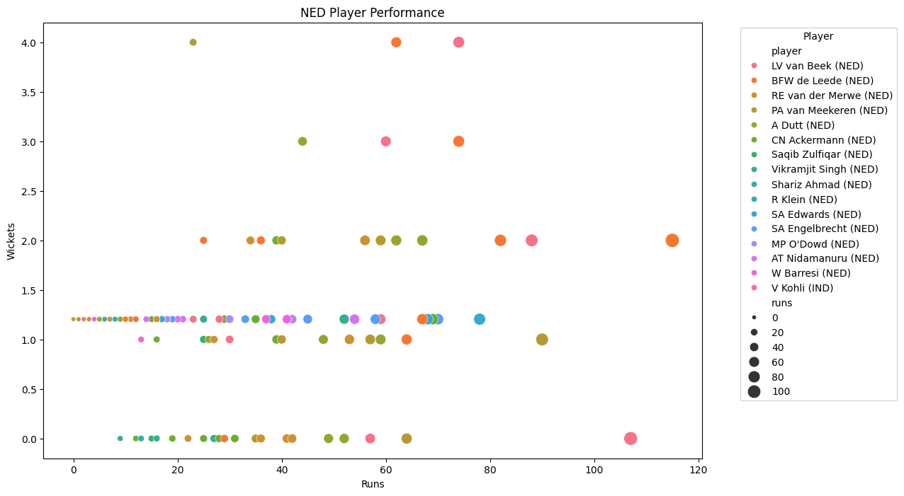
Individual player performance within each top-performing team

Slide 20
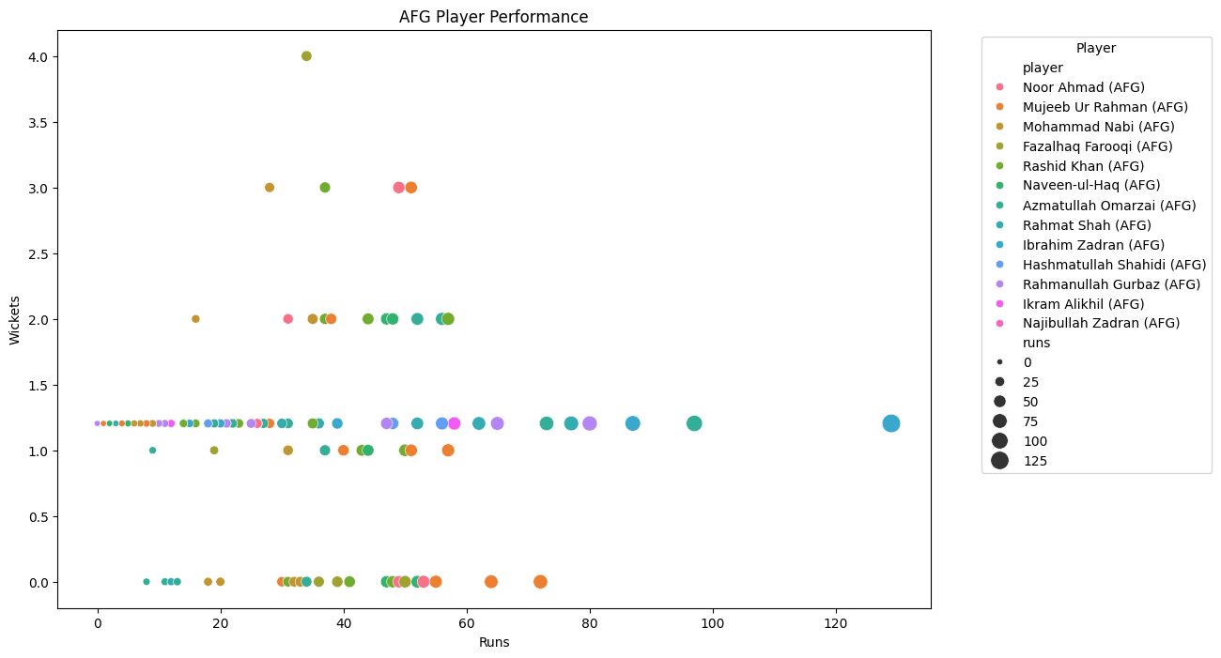
Individual player performance within each top-performing team
New Zealand (NZ):
MJ Henry, LH Ferguson, and TA Boult have been the standout performers with consistent wicket-taking abilities.
They have maintained relatively low runs conceded and good economy rates.
Their strike rates indicate they take wickets at a reasonable frequency.
Not out percentages suggest they contribute with the bat occasionally.
Australia (AUS):
A Zampa, MR Marsh, and PJ Cummins have been the notable performers.
They have managed to take wickets consistently while keeping the runs conceded under control.
The economy rates are decent, indicating good control over the game.
Not out percentages suggest they contribute with the bat occasionally. performances in both batting and bowling styles.

Slide 21
Individual player performance within each top-performing team
South Africa (SA):
G Coetzee, KA Maharaj, and L Ngidi have been notable performers.
They have taken wickets consistently but have conceded runs at a slightly higher rate compared to other teams.
The strike rates indicate they take wickets at a reasonable frequency.
Not out percentages suggest they contribute with the bat occasionally.
Pakistan (PAK):
Shaheen Shah Afridi, Mohammad Wasim, and Haris Rauf have been notable performers.
They have been effective in taking wickets but have occasionally struggled with higher economy rates.
The strike rates indicate they take wickets at a reasonable frequency.
Not out percentages suggest they contribute with the bat occasionally.
India (IND):
Kuldeep Yadav, Mohammed Shami, and JJ Bumrah have been standout performers.
They have maintained low runs conceded and good economy rates.
The strike rates indicate they take wickets at a reasonable frequency.
Not out percentages suggest they contribute with the bat occasionally.
England (ENG):
DJ Willey, AU Rashid, and RJW Topley have been notable performers.
They have taken wickets consistently while maintaining decent economy rates.
The strike rates indicate they take wickets at a reasonable frequency.
Not out percentages suggest they contribute with the bat occasionally.

Slide 22
Individual player performance within each top-performing team
Sri Lanka (SL):
D. Madushanka and A.D. Mathews have shown good bowling performances with high wicket counts in some matches.
S. Samarawickrama and other batsmen have struggled to score runs in certain matches, with low or zero runs.
Bangladesh (BAN):
Mehidy Hasan Miraz, Shoriful Islam, and Tanzim Hasan Sakib have shown good bowling performances with decent wicket counts.
Nasum Ahmed has shown good economy rates in bowling.
Netherlands (NED):
P.A. van Meekeren and L.V. van Beek have performed well in bowling, with good wicket counts in some matches.
Some batsmen like C.N. Ackermann and A. Dutt have struggled to score runs in matches.
Afghanistan (AFG):
Noor Ahmad and Mujeeb Ur Rahman have shown good bowling performances with decent wicket counts.
Some batsmen like Naveen-ul-Haq and Rahmanullah Gurbaz have struggled to score runs in matches.

Slide 23
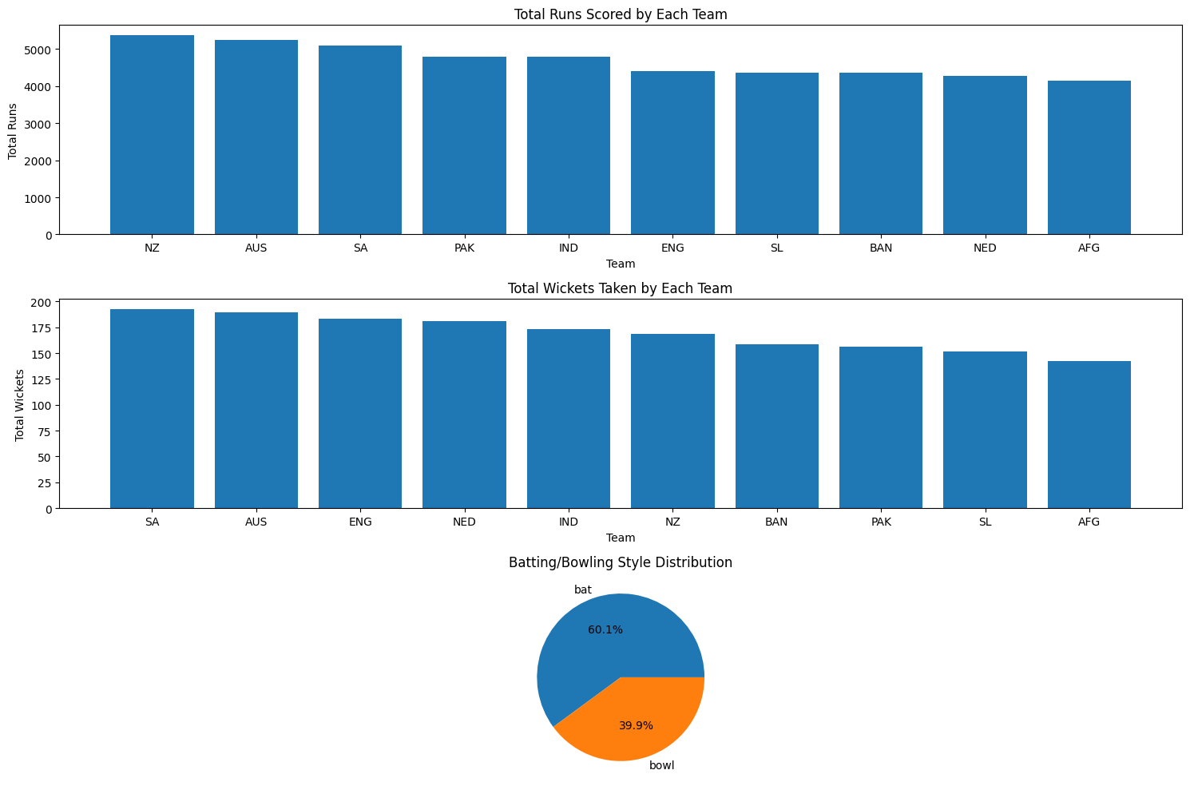
Overall Analytics

Slide 24
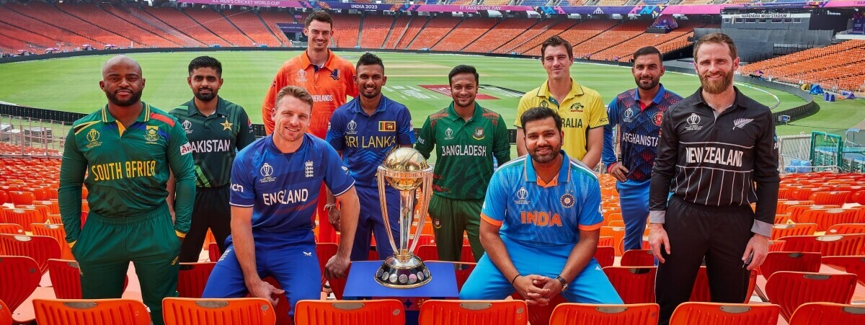
Player Performance Analysis

Slide 25
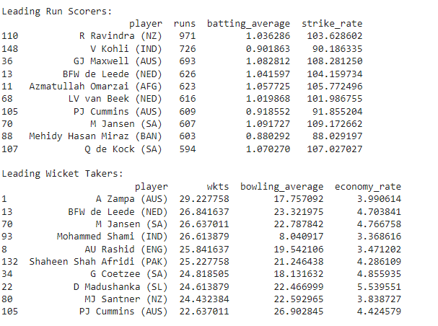
Player Performance Analysis
Calculated the statistics by batting and bowling
Identifying leading runners and wicket takers

Slide 26
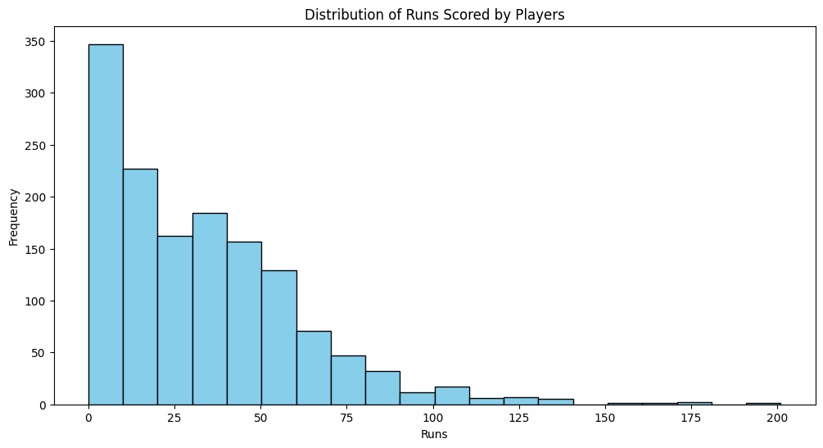
Overall runs scored by players

Slide 27
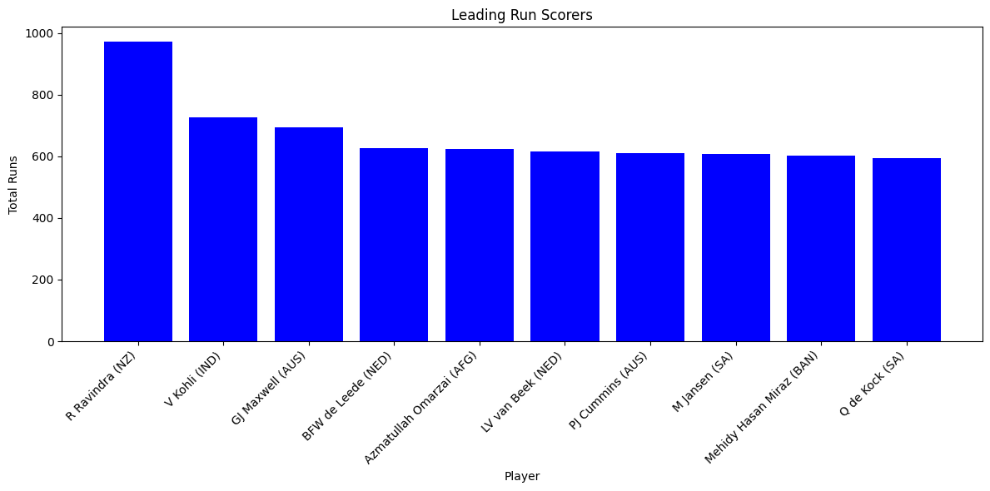
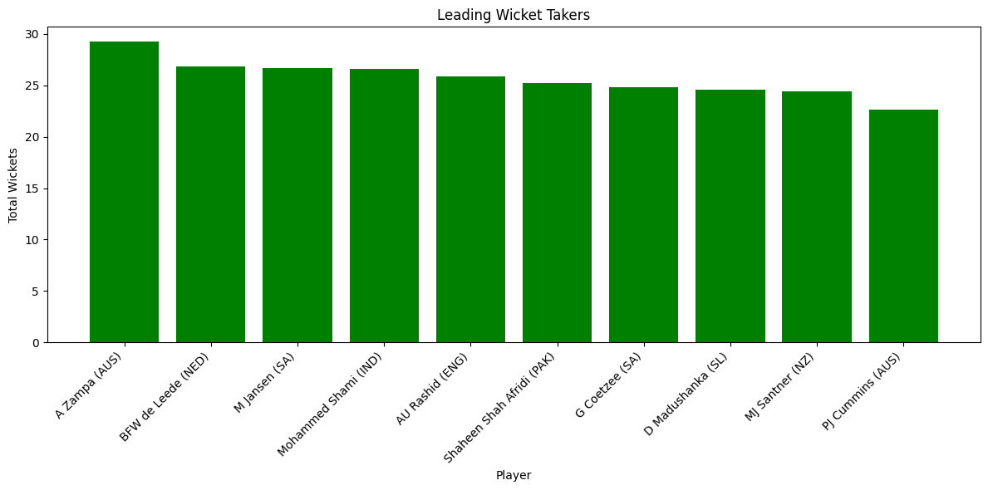
Leading players
Runs
Wickets

Slide 28
Opposition and Ground Analysis
Calculated and visualized:
Performance against different oppositions
Performance variations across different playing grounds
Team performance comparison
Player performance comparison

Slide 29
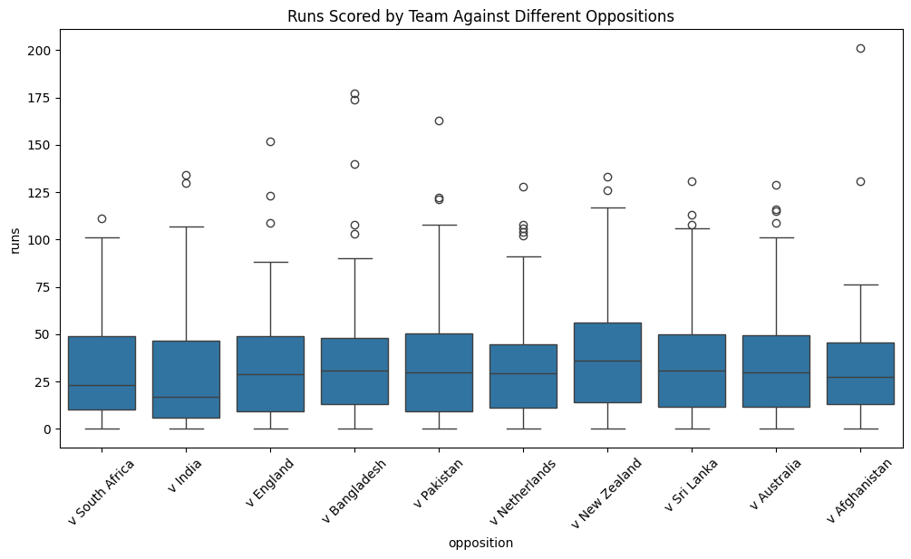
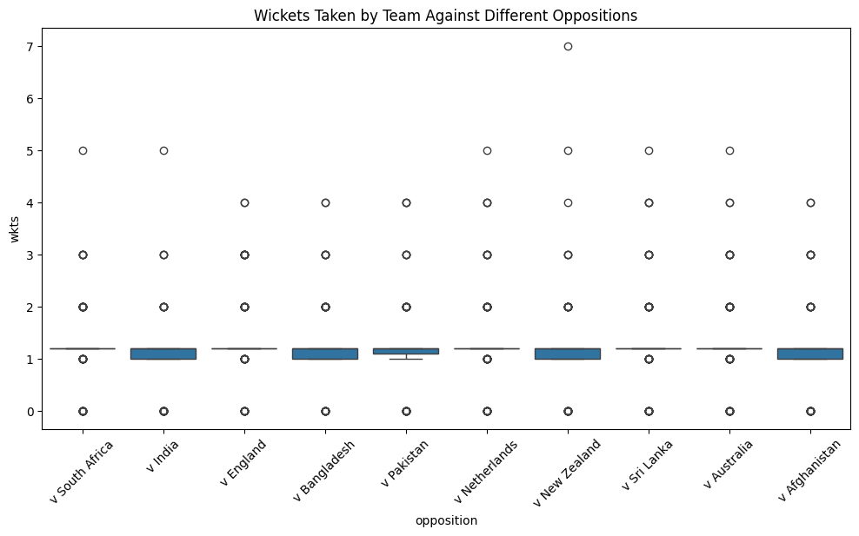
Performance against opposition
Runs
Wickets

Slide 30
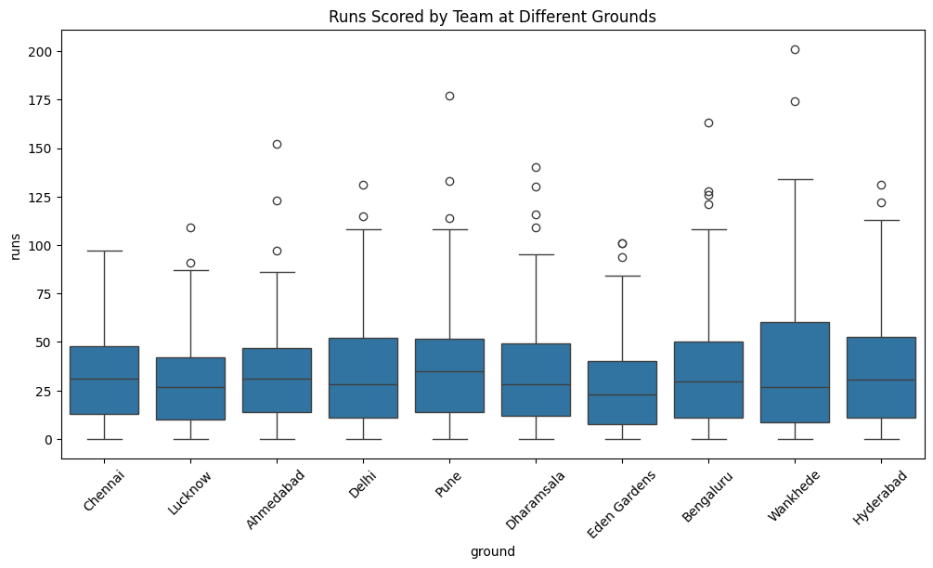
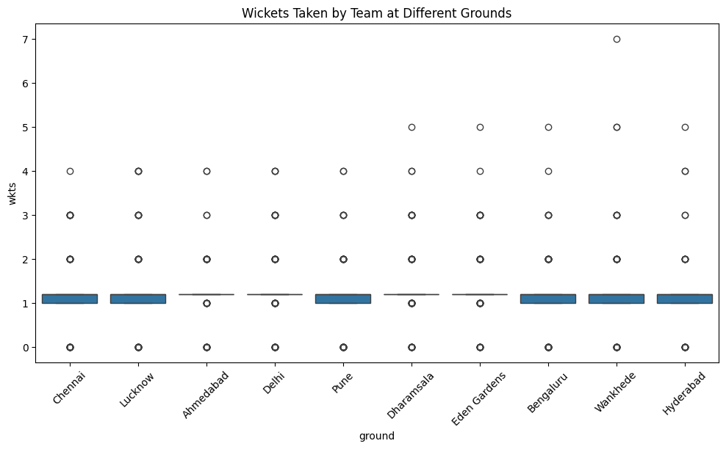
Performance across grounds
Runs
Wickets

Slide 31
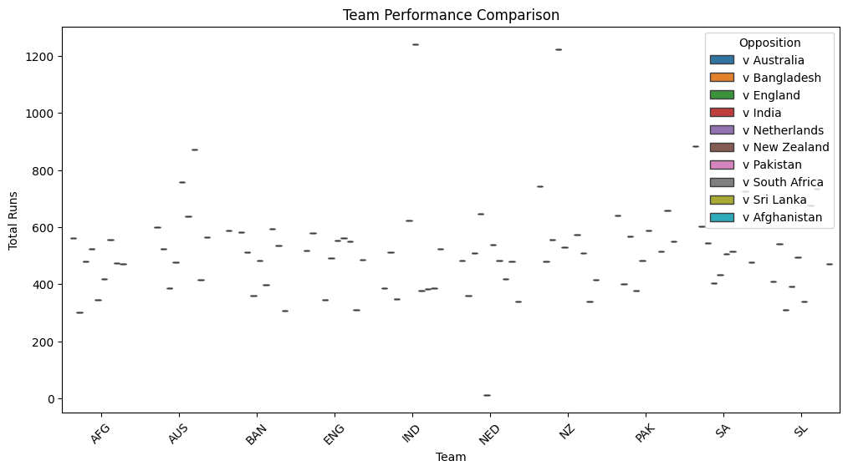

Team Performance Comparison
Runs
Wickets

Slide 32
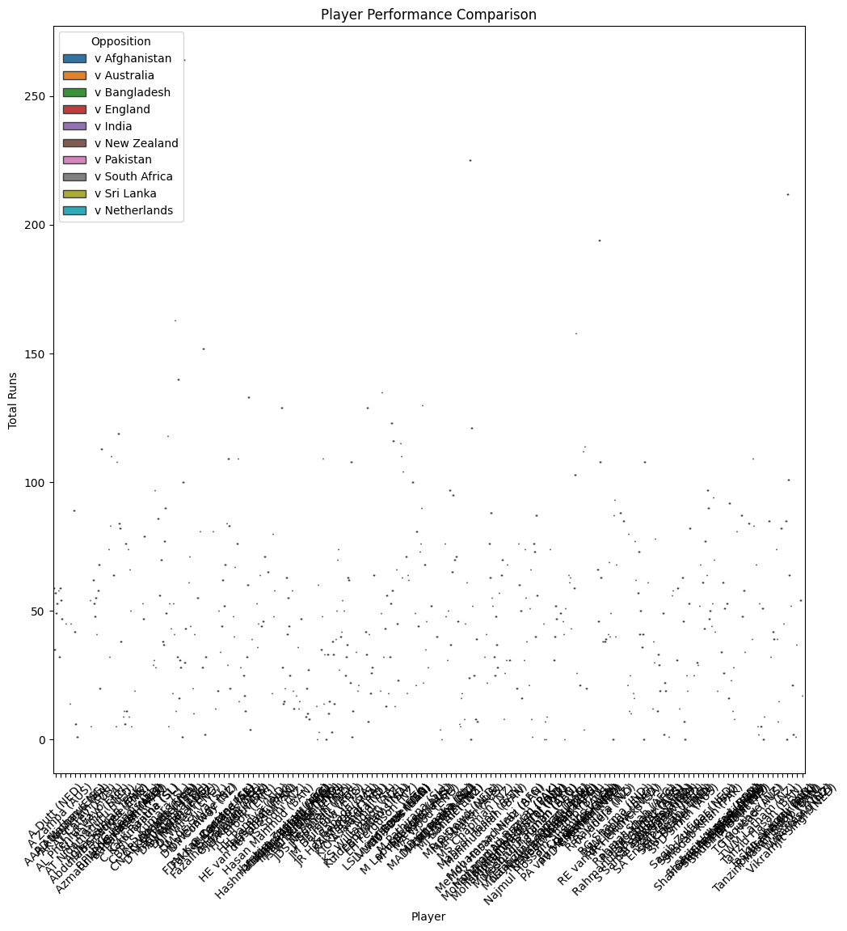
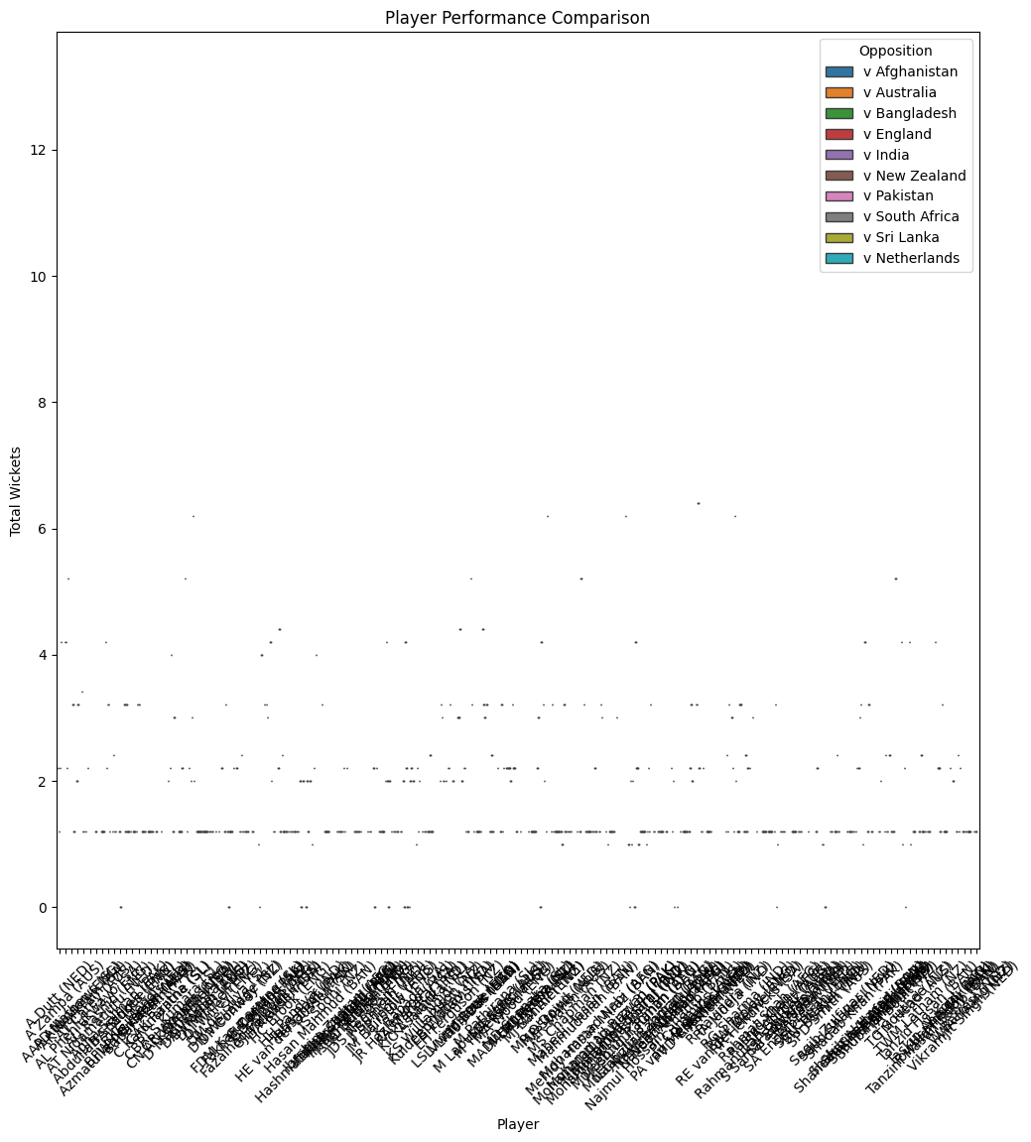
Player Performance Comparison
Runs
Wickets

Slide 33
Temporal Analysis
Converted start_date into date time format
Analyzed Team performance over time
Analyzed player performance over time

Slide 34
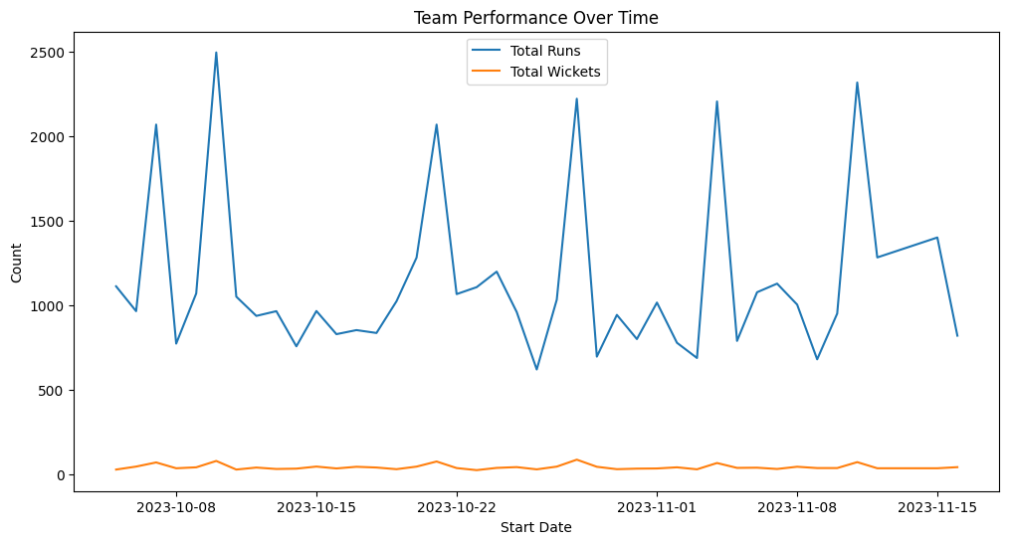
Team Performance Over Time

Slide 35
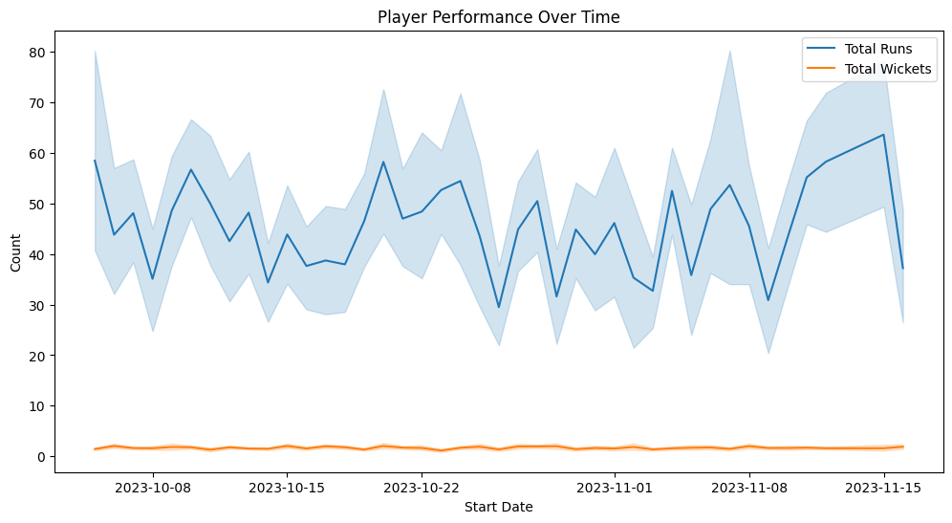
Player Performance Over Time

Slide 36
Prediction Model
Model for predicting the number of runs a player might score.
Divided the dataset into X and Y set’s i.e. train and test.
Converted date into numerical format
Encoded the categorical variables.
Trained the model.
Evaluated the model with mse.

Slide 37
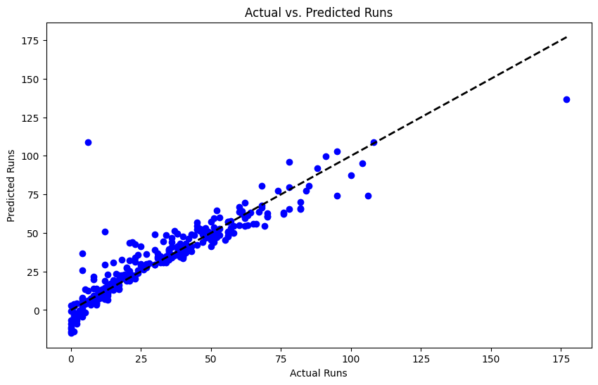
Prediction model analysis
This is a scatter plot where the x-axis represents the actual runs and the y-axis represents the predicted runs. The diagonal line represents a perfect prediction where the actual and predicted values are the same. Points that fall closer to this line indicate better predictions by the model.

